Slide 1

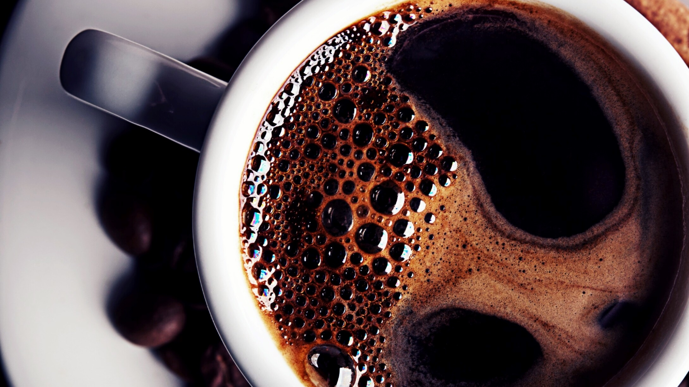
Image Processing in Practice
Project: Automatic Test Scoring

Slide 2
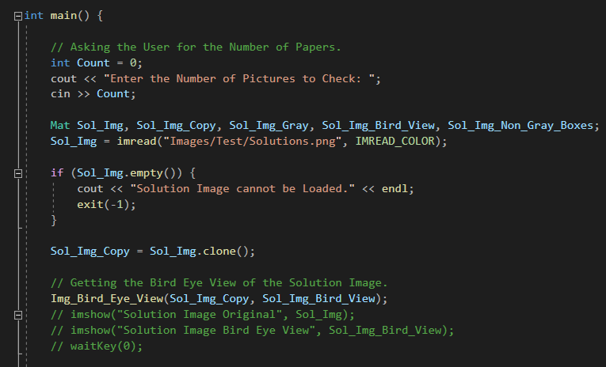
Getting the Solution Image First
We have to get the Solution Image or Image with Answers first. Because we will not be Loading it every time but we will load a Question Paper check it show correct Answers marked to the User and move to another Image. So, first we need to load it and also check if it is correctly loaded or not later we need to Crop it and get the Bird Eye View of the Image which will remove the parts that are not needed and we will do it using Img_Bird_Eye_View() function.

Slide 3
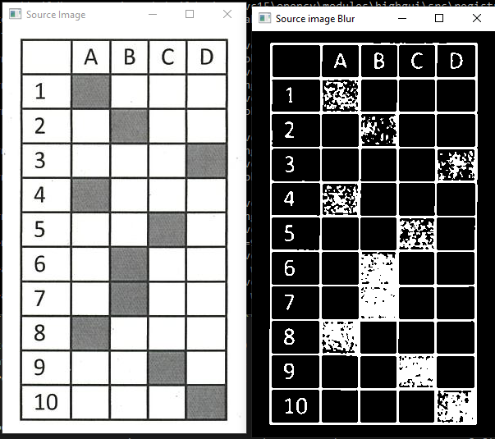
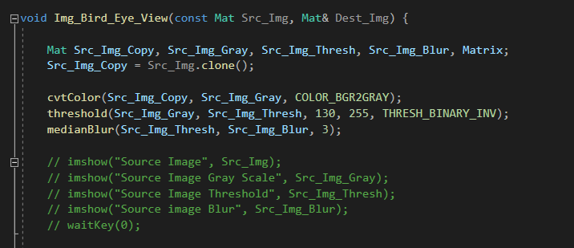
Getting the Bird Eye View of Image (1)
We have to Extract the important part of the Image and Remove the other parts not needed. For that, we will convert it to grayscale and later use threshold() and then we will find Contours on Image. This Image shows the Original Image and Image after applying threshold() and medianblur().

Slide 4
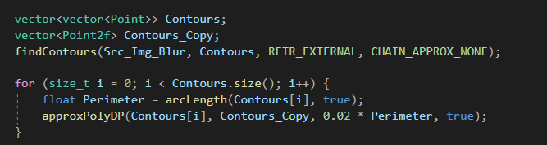
Getting the Bird Eye View of Image (2)
After that we need to find the Contours using findcontours(). And later we will use arcLength() and approxPolyDP() to approximate the Contours so it is easier to find the correct Contour rounding the Image.

Slide 5
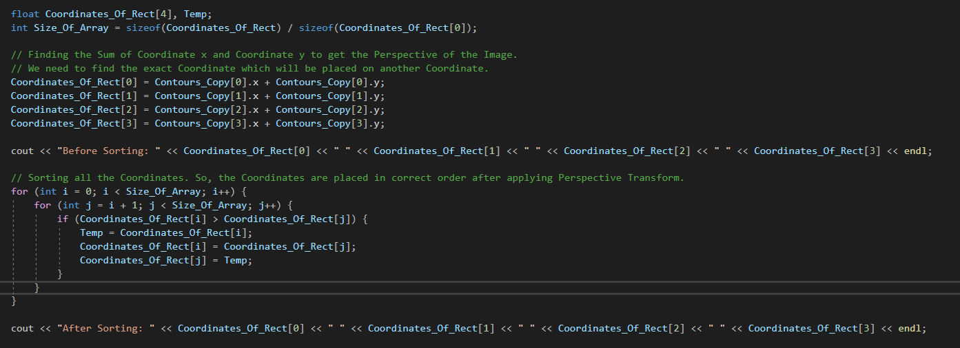

Getting the Bird Eye View of Image (3)
Now we have the Coordinates of the Contours. But if we just apply the function to Extract this Image then some Coordinates might not get Extracted to the correct place. Like there are some tilted pictures. For that, we need to add x and y Coordinate and then sort them in order. By doing this we will know which Coordinate is first which is second so it will be easy to Extract them later.

Slide 6
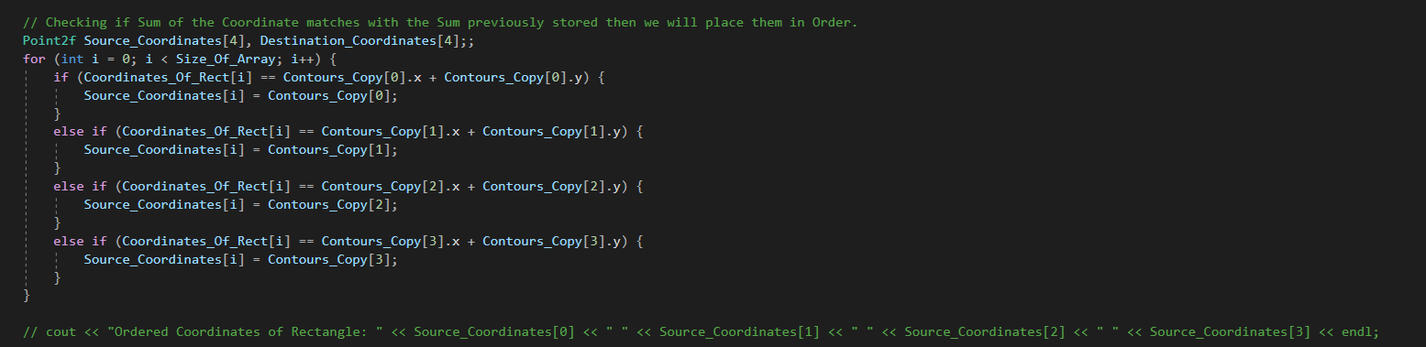

Getting the Bird Eye View of Image (4)
We have got the sum of x and y Coordinates Sorted out. But now we need to find which was the x and y value originally which can be found after comparing each Coordinate’s x and y sum. Then we will store them in an Array as Source Coordinates.

Slide 7
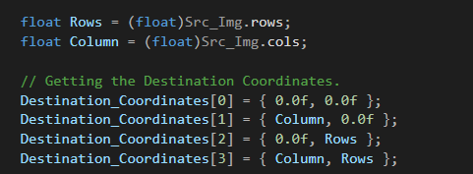
Getting the Bird Eye View of Image (5)
We have found the Ordered Source Coordinates. Now for Destination Coordinates we want that Image should be of same size so we will just get the Rows and Columns of the Original Image and Initialize the Destination Coordinates.

Slide 8
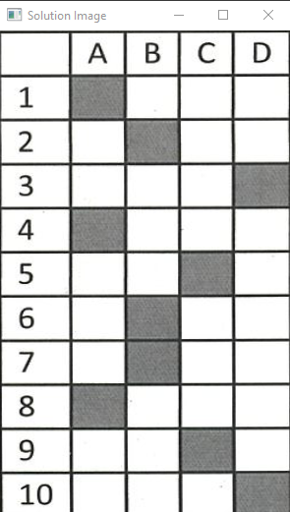
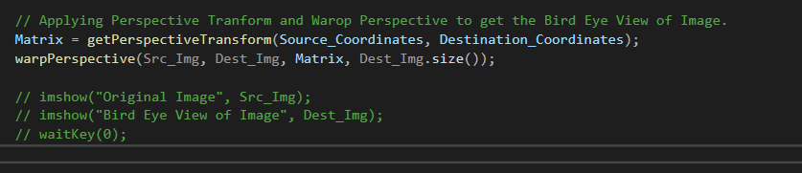
Getting the Bird Eye View of Image (6)
Now we know the Source Coordinates and Destination Coordinates we just need to use getPerspectiveTransform() and warpPerspective() to get the Bird Eye View of the Image. getPerspectiveTransform() calculates a perspective transform and gives a Matrix from four pairs of the corresponding points. warpPerspective() applies a perspective transformation to extract the required piece of the Image.

Slide 9
Quick Reminder
We can use boundingrect() Function to the Contours and extract the Image which is like the easiest code of two lines. But there is a problem it doesn’t work for the other Images which are tilted. So, we worked on this Function which is Img_Bird_Eye_View(). It will give us the Bird Eye View of the Image by extracting it using the getPerspectiveTransform() and warpPerspective().

Slide 10
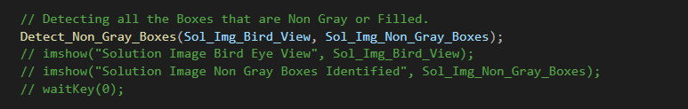
Detecting the Non-Gray Boxes (1)
After we have found the Bird Eye View of the Image, we need to find the Boxes that are Non Gray or Boxes that are filled. For that, we will call a function which is Detect_Non_Gray_Boxes().

Slide 11
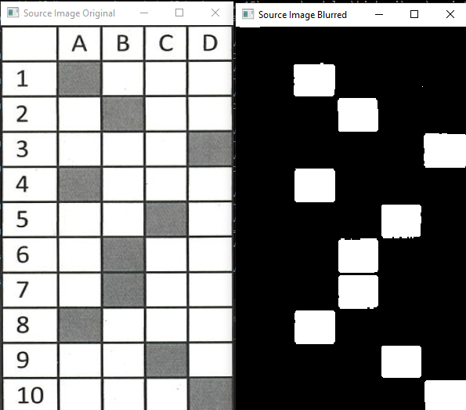
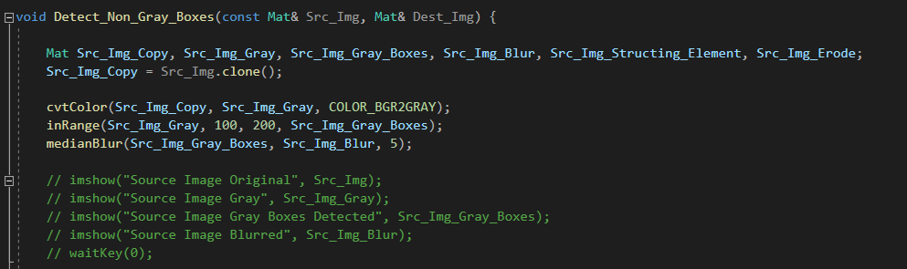
Detecting the Non-Gray Boxes (2)
To Detect the Non Gray Boxes. First we need to change the Image from Color to Grayscale. After converting it we will use inRange() function which will return an array which will consist elements that are equal to 0, only if the elements of the Source picture lie between Upper Bound and Lower Bound. Later, we will use medianBlur() to remove Noise.

Slide 12
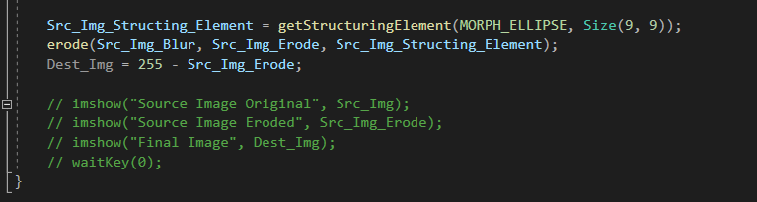
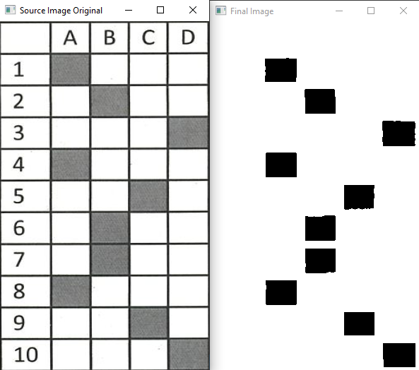
Detecting the Non-Gray Boxes (3)
After we have got the Result from inRange() function in which we have identified the Boxes that are Non-Gray, then we removed the Noise. Now we will pass our picture and size to getStructuringElement() which will give us the desired kernel. And later we will use erode() function which will erode the boundaries of foreground object and will give us the Boxes that are filled.

Slide 13
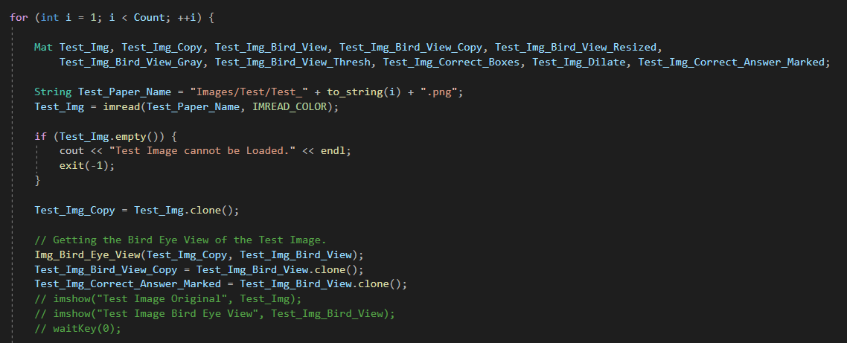
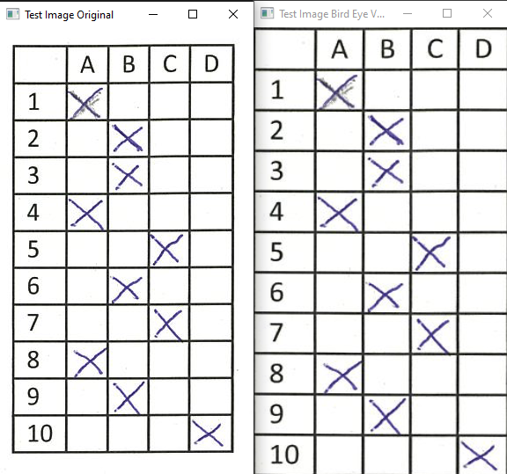
Loading the Test Images
Till now we have loaded the Solution Image we found the Bird Eye View of the Image and later we found out the Non-Gray Pixels or Boxes that ae filled. Now we will load the Test Images and since there are many Test Images we will use a for loop. We will load an Image then check it is correctly loaded or not then we will send it to Img_Bird_Eye_View() Function which will give us the Bird Eye View of the Image. And we will do this for every Test Image.

Slide 14
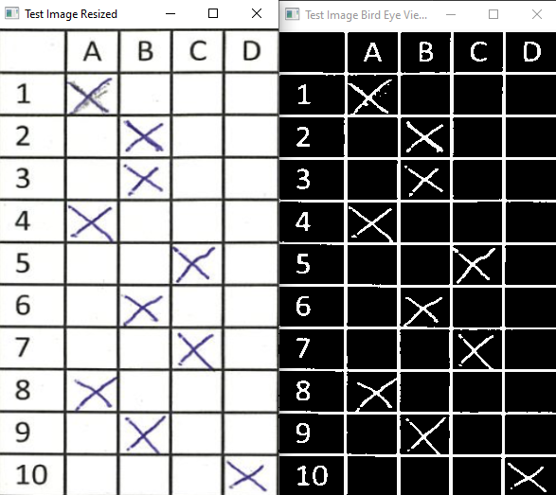
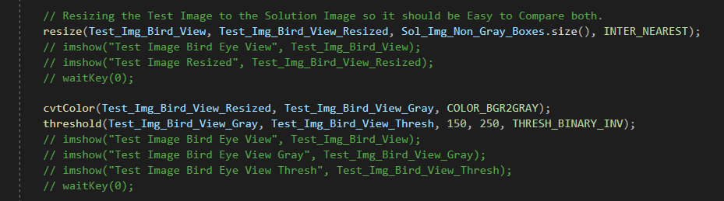
Getting the Results (1)
Now we have found the Bird Eye View of the Image using Img_Bird_Eye_View(). Later we will resize the Test Image using resize() function according to the Solution Image in which we have Detected Non-Gray Boxes. Then, we will convert it to Grayscale and after that we will use the threshold() to get the Mask of the Image.

Slide 15
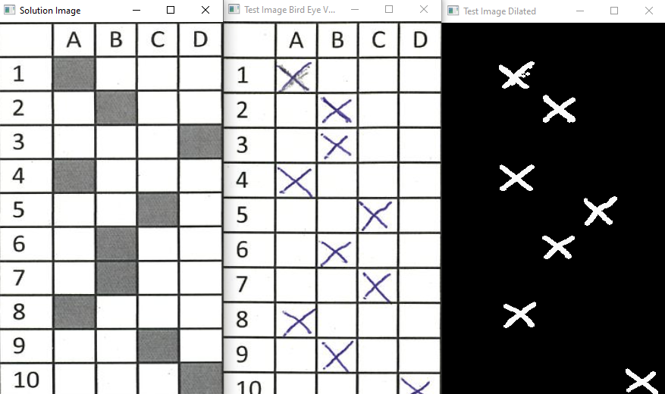
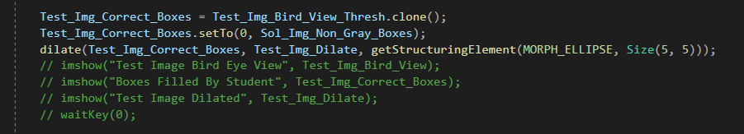
Getting the Results (2)
Now after applying threshold using threshold() function and getting Mask of the Image we will again use getStructuringElement() but now we will not be using it to Erode using erode() function but we will use dilate() function for Dilation. Dilation increases the size of the foreground object. Hence, we will get all correct objects or Boxes that were correctly filled by the Student.

Slide 16
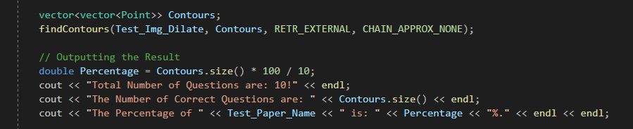

Showing the Results (1)
We have found the Questions that were correctly filled by the Student. We can just use findContours() which will find the Number of Correct Answers and we will Output the Size of Contours using .size() function which will show Number of Correct Answers. Now, we can show this Result to the User and other things like How much Questions there are? How much Questions are Correct? And how much Percentage he/she got?

Slide 17
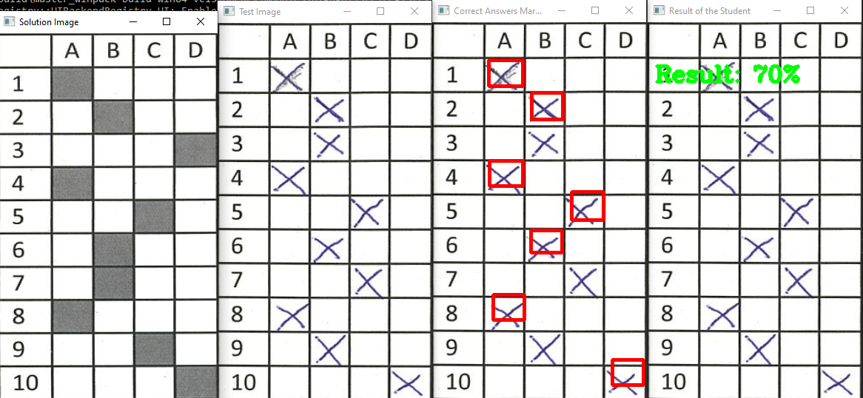
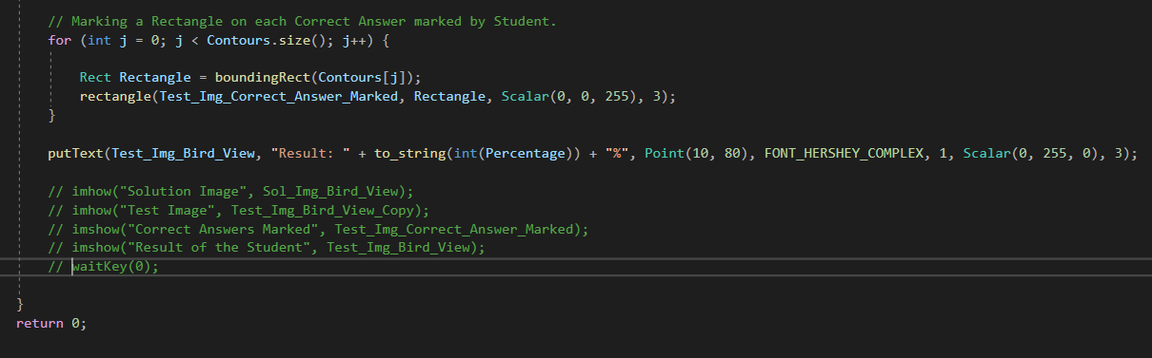
Showing the Results (2)
We have shown the Result to User. Now we will show this Result on each Test Paper so it is easy to see which Question is Correct and which is Incorrect. And for that we will Draw a Rectangle using rectangle() Function on each Question that is Correct. And later using putText() function we will show what is the Result?

Slide 18
The End

